Slide 1

Idle Free Essex County
Essex County Board of Chosen Freeholders
December 5, 2012
Jennifer Duckworth | Essex County Environmental Commission | jennifer@jenniferduckworth.com

Slide 2


Idle Free Essex County
Address common misconceptions about idling
Discuss vehicle idling in New Jersey
Tell you what you what the Essex County Board of Chosen Freeholders can do about idling
But first a quiz…
Notes:
What is idling?
In general: Something or someone is not operating or not moving
In this presentation: Cars that have their engines running but are stationary.
In this short presentation, we will discuss vehicle idling in New Jersey, common misconceptions and tell you what you can do about idling.
BUT FIRST A QUIZ…

Slide 3
Is it better to turn off your car rather than leaving it running?
Idling for more than 10 seconds uses more fuel than restarting the engine
Frequent restarting has an impact on battery and starter
Catalytic converters, on vehicles to reduce pollution, stay warm for 25+ minutes - frequent stops and starts not as harmful as cold starts
Yes!
Notes:
From http://auto.howstuffworks.com/catalytic-converter1.htm
Pollutants Produced by a Car Engine
In order to reduce emissions, modern car engines carefully control the amount of fuel they burn. They try to keep the air-to-fuel ratio very close to the stoichiometric point, which is the calculated ideal ratio of air to fuel. Theoretically, at this ratio, all of the fuel will be burned using all of the oxygen in the air. For gasoline, the stoichiometric ratio is about 14.7:1, meaning that for each pound of gasoline, 14.7 pounds of air will be burned. The fuel mixture actually varies from the ideal ratio quite a bit during driving. Sometimes the mixture can be lean (an air-to-fuel ratio higher than 14.7), and other times the mixture can be rich (an air-to-fuel ratio lower than 14.7). The main emissions of a car engine are:
Nitrogen gas (N2) - Air is 78-percent nitrogen gas, and most of this passes right through the car engine.
Carbon dioxide (CO2) - This is one product of combustion. The carbon in the fuel bonds with the oxygen in the air.
Water vapor (H2O) - This is another product of combustion. The hydrogen in the fuel bonds with the oxygen in the air.
These emissions are mostly benign (although carbon dioxide emissions are believed to contribute to global warming). But because the combustion process is never perfect, some smaller amounts of more harmful emissions are also produced in car engines:
Carbon monoxide (CO) - a poisonous gas that is colorless and odorless
Hydrocarbons or volatile organic compounds (VOCs) - produced mostly from unburned fuel that evaporates Sunlight breaks these down to form oxidants, which react with oxides of nitrogen to cause ground level ozone (O3), a major component of smog.
Nitrogen oxides (NO and NO2, together called NOx) - contributes to smog and acid rain, and also causes irritation to human mucus membranes
These are the three main regulated emissions, and also the ones that catalytic converters are designed to reduce.

Slide 4
Is it important to idle for a few minutes to warm up the engine‚ especially in winter?
Tests show no more than 30 seconds needed to circulate engine oil
All parts of the vehicle (transmission, tires, suspension, steering and wheel bearings) need to warm up, not just the engine
Catalytic converters only work at high temperatures and minimally reduce pollution when cars are cold
Best way to warm up your vehicle is to drive it
No!
Notes:
http://oee.nrcan.gc.ca/transportation/idling/issues/why-idling-problem.cfm?attr=8#wastes
http://oee.nrcan.gc.ca/communities-government/transportation/municipal-communities/articles/idling-tips.cfm?attr=8
With computer-controlled‚ fuel-injected engines‚ need no more than 30 seconds of idling.
Warming up the vehicle means more than warming the engine. The tires‚ transmission‚ wheel bearings and other moving parts also need to be warmed up for the vehicle to perform well. Most of these parts don’t begin to warm up until you drive the vehicle.
The catalytic converter – the device that cleans pollutants from the vehicle’s exhaust – doesn’t function at its peak until it reaches between 400°C and 800°C. Again‚ the best way to warm the converter is to drive the vehicle. Driving a vehicle cuts warm-up times in half. This reduces fuel consumption and GHG emissions.

Slide 5
Isn’t idling good for a vehicle?
Idling can damage engines
Engine isn’t at peak operating temperature
Fuel doesn’t undergo complete combustion
Idling leaves fuel residues that can contaminate engine oil and damage engine parts
Excessive idling can allow water to condense in vehicle’s exhaust
Fuel injected vehicles don’t require idling unlike carbureted engines of the past
No!
Notes:
Can idling damage my car’s engine?
You bet it can! Because the engine isn’t working at its peak operating temperature when it’s idling‚ the fuel doesn’t undergo complete combustion. This leaves fuel residues that can contaminate engine oil and damage engine parts. For example‚ fuel residues tend to deposit on spark plugs. As the amount of engine idling increases‚ the average temperature of the spark plugs drops. They begin to gather dirt more quickly which‚ in turn‚ may increase fuel consumption. It’s a vicious cycle of wasted fuel and needless greenhouse gas emissions. Excessive idling can also allow water to condense in the vehicle’s exhaust. This can lead to corrosion and reduce the life of the exhaust system.

Slide 6


Why do people idle?
Winter to warm up vehicle or stay warm
Summer to stay cool
School drop-off and pick-up
Waiting for someone
Charging cell phone
Drive-thru windows
Gas stations
Using automatic vehicle starters
Commercial vehicles
Force of habit
Notes:
Vehicle idling has increased recently due to people idling while talking on their cell phones and remote vehicle starters.
The automotive industry is offering more and more remote starters because they can be sold for an incredible markup price.

Slide 7
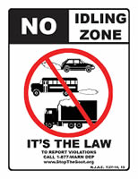
Idling in New Jersey
NJ State Law prohibits idling more than three minutes for both diesel and gasoline vehicles
N.J.A.C. 7:27-14, 15 and N.J.S.A. 39:3-70.2
2008 enforcement summary
Raises minimum penalty amount from $25 to $250
Idling can be enforced on public roads
Penalty monies go to local police/municipality
2012 enforcement summary
Idling can be enforced on public roadways and on private property
Municipalities pass the No Idling Resolution
Notes:
New Jersey prohibits idling of both diesel vehicles, such as school buses and large trucks, (and gasoline-powered vehicles), for more than three minutes. • Annually in New Jersey, 400 to 800 premature deaths, 16,000 asthma attacks and 1,800 emergency room visits are directly related to diesel fuel emissions. The U.S. EPA has determined that diesel exhaust is a "likely human carcinogen". • Diesel combustion releases fine particles and gases into the air, known as soot. Children are particularly vulnerable to the effects of soot. Children's immune and respiratory systems are still developing and they breathe up to 50 percent more air per pound of body weight than adults. • Diesel exhaust worsens the symptoms of asthma, bronchitis and emphysema and can trigger an asthma attack in someone who never has had asthma. • Between 10 and 13 percent of all students in grades K-12 have asthma. • In 2003, 14,500 school buses operated in New Jersey. Each child rides a school bus an average of 1.5 miles per day. • For more information, visit www.stopthesoot.org • Call (877) WARN-DEP (877-927-6337) to report idling. • Idling penalties for commercial vehicles and property owners are $250 for the first offense, $400 for the second, $1,000 for the third and $3,000 for the fourth and each subsequent violation. • In 2005, the NJ DEP observed 5,000 vehicles at 1,300 sites and cited 130 violations for idling. During the same time, county environmental health agencies observed 1,700 vehicles at 500 sites and issued 30 idling violations. Source: N.J. Department of Environmental Protection

Slide 8

Why stop idling?
Health benefits
Breathing polluted air causes asthma, lung problems and allergies
Children breathe at tailpipe level and at a faster rate than adults, so breathe more polluted air
Climate change related issues
Save fuel and money
1/10 gallon per 20 minutes
90¢ per hour @ $3.00/gallon
10 minutes of idling uses as much fuel as traveling 5 miles
Increase the life of vehicles
Reduce greenhouse gasses
Prevent climate change
Catalytic converters form nitrous oxide, a potent greenhouse gas
19 pounds CO2 per gallon gas
Reduce air pollution
Especially when vehicle is cold
Exposure to pollutants actually higher inside vehicle
Notes:
Asthma rates among children in some parts of North America are four times higher than they were 20 years ago.
http://www.cbc.ca/story/canada/national/2006/01/27/asthma-report060127.html
Many people believe that they are protected from air pollution if they remain inside their vehicles. Not so according to a report by the International Center for Technology Assessment (CTA). CTA found that exposure to most auto pollutants, including volatile organic compounds (VOCs) and carbon monoxide (CO), is much higher inside vehicles than at the road side. VOCs and CO are linked to serious health problems--like respiratory infections and cancer--are known to shorten life. The highest exposure occurs when sitting in traffic congestion on highways or in a line-up of idling vehicles at a school or drive-through. http://www.hcdoes.org/airquality/Anti-Idling/idle.htm
A car uses 106 ounces of gas idling for one minute. Half an ounce is used to start the average automobile. http://local.aaca.org/junior/4wheelfun/trivia/gasoline.htm

Slide 9
What can I do?
If you’re going to be stopped for more than a minute‚ turn off your car
Plan for the weather (dress appropriately, use blankets)
Minimize warm-up idling to 30 seconds
Warm-up all parts of vehicle by starting slow
Walk in instead of drive through
Limit use of remote car starters
Buy a hybrid or electric car
Educate others about idling
Notes:
Minimize warm-up idling. This is especially. Drive away after no more than 30 seconds of idling‚ assuming the vehicle’s windows are clear.
If you’re going to be stopped for more than 10 seconds‚ turn off the engine. Now I’m not talking about at red lights or in traffic – that’s a safety issue. What I am talking about is to never leave the vehicle running while you zip into a corner store or fast-food restaurant – it’s hard on your pocketbook‚ bad for the environment and an invitation to car thieves.
Avoid using remote car starters. They encourage you to start your car before you’re ready to drive‚ resulting in needless idling.
Idling emits more pollution if the vehicle’s catalytic converter isn’t working properly. Ask your technician to check the system the next time your car is being serviced.
Use a block heater to warm the engine before you start it
Reduces engine wear‚ improves fuel efficiency and reduces emissions by 10 percent or more in cold conditions
Use an automatic timer to turn on the block heater two hours before you plan to start the vehicle

Slide 10
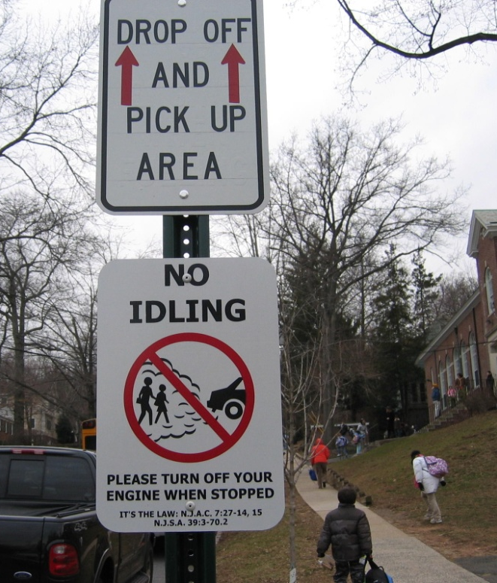
What can the Essex County Board of Chosen Freeholders do?
Adopt the Essex County No Idling Resolution
Advocate for posting signs at public locations prone to idling
Support Essex County Environmental Commission’s efforts to distribute bookmarks, stickers, and other promotional handouts

Slide 11
Where can I get more information?
Idle free New Jersey www.cleanwateraction.org/feature/idlefreenj
NJ DEP What Your Town Can Do About Idling www.nj.gov/dep/stopthesoot/sts-whatyourtowncando.htm
Natural Resources Canada, Office of Energy Efficiency, Idle Free Zone idling.gc.ca
Notes:
Idle Free Campaigns:
· Canada
- Canadian Idle Free Zone: <http://idling.gc.ca/>
- Green Communities Active & Safe Routes to School: <http://www.saferoutestoschool.ca/index.php>
- Mississauga Anti-Idling Campaign – Successful, Federally funded campaign: <http://www.utm.utoronto.ca/1701.0.html> and <http://www5.mississauga.ca/idlefree/campaign.htm>
- Markham/Newmarket Idle-free Challenge - Example Kids Campaign: <http://oee.nrcan.gc.ca/transportation/idling/material/idle-free-challenge.cfm?attr=24>
Northwest Region
- Airwatch Northwest – Washington, Oregon, Idaho, and British Columbia - No Idle Zone / Anti-Idling: <http://www.airwatchnorthwest.org/wa/NO_IDLE/Anti_Idle_FactSheet_long.html>.
- Oregon Environmental Council’s It’ Not Cool to Idle in School Program: <http://www.oeconline.org/kidshealth/teachertools>
· Northeast Region
- Bethlehem, NY - Bethlehem Central Adopts No Idling Policy News Release: <http://bcsd.k12.ny.us/news/2004-05/050217noidling.htm>
- Burlington, VT - 10% Challenge: <http://www.10percentchallenge.org/> and click on No-Idling Campaign.
- Lenox, MA – A Healthy Climate. No Idle Task: <http://www.cleanair-coolplanet.org/champions/2004_dec.php>
· Millburn, NJ - Do Your Part - Idle-Free – Article 8 (of 10): <http://laptoplunches.com/newsletters/SeptemberNewsletter_2006.html> and <http://www.wastefreelunches.org/IdleFree.ppt>
Health Related Information:
Children’s Asthma - The Canadian Broadcasting Corporation finds that Asthma rates in children have jumped fourfold and zeroed in on two factors: Outside air pollution and Smoke in the home. <http://www.cbc.ca/story/canada/national/2006/01/27/asthma-report060127.html>
· Children’s Health and the Environment in North America by the Commission for Environmental Cooperation: <http://www.cec.org/files/PDF/POLLUTANTS/CEH-Indicators-fin_en.pdf>
· Americal Lung Association State of the Air 2006 Report: <http://www.lungusa.org/site/apps/nl/content3.asp?c=dvLUK9O0E&b=40407&ct=2315173>
· In-Car Air Pollution by the International Center for Technology Assessment: <http://www.icta.org/doc/In-car%20pollution%20report.pdf>
Catalytic Converters:
EPA says Catalytic Converter is Growing Cause of Global Warming: <http://www.junkscience.com/news2/catalyt.htm>
· Autos' Converters Increase Warming As They Cut Smog: A Split Over Solutions: <http://www.his.com/~sepp/Archive/controv/controversies/catalytic.html>
· How Catalytic Converters Work: <http://www.howstuffworks.com/catalytic-converter.htm>
· Additional Information on Nitrous Oxide: <http://en.wikipedia.org/wiki/Nitrous_oxide>

Slide 12
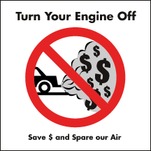
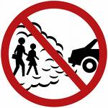
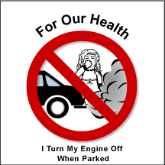
Idle Free You and Me
There are so few things that are good for you
and so easy to do
and you can pat yourself on the back and say,
“I did something good today.”

